Slide 1
PLANT DISEASE DETECTION
Rekha V– 19BCE1871
MaulisHree Awasthi – 19bce1864

Slide 2
CONTENTS
ABSTRACT
PROBLEM DEFINITION
SURVEY ANALYSIS
REQUIREMENT SPECIFICATIONS
DATASET
DATASET PROPERTIES AND SAMPLE
MODULES DESCRIPTION
CONCLUSION

Slide 3
ABSTRACT
Agriculture plays a significant role to both human and economy of a nation; that is to say, it is the backbone of a nation's economy. In addition to providing food and raw material, it also provides employment opportunities to very large percentage of the population.
To promote sustainable development, the smart city implies a global vision that merges various technologies like artificial intelligence, big data, decision making, information and communication technology (ICT), and the Internet-of-Things (IOT). These processes above are related for solving real life problems.

Slide 4
PROBLEM DEFINITION
When we think about technologies in Agriculture, Plant Disease Detection is one of the most mind boggling issue that exists. We can easily say that new technologies are being developed and researches are being done to detect weather a plant is healthy or diseased by many methods in today’s world. Be it using Deep Learning and with the help of Neural Network, new techniques are still being discovered.
Our approach for Detecting weather a plant leaf is healthy or unhealthy is by using a classical Machine Learning Algorithm , Pre-processing the data using Image Processing.
Machine based approaches for disease detection and classification of agricultural product have become an important part of civilization.

Slide 5
SURVEY ANALYSIS
Identification of the plant diseases is the key to preventing the losses in the yield and quantity of the agricultural product. It requires tremendous amount of work, expertise in the plant diseases, and also require the excessive processing time. Hence, image processing is used for the detection of plant diseases. Disease detection involves the steps like image acquisition, image pre-processing, image segmentation, feature extraction and classification. This method uses the detection of plant diseases using their leaves images. The accurate detection and classification of the plant disease is very important for the successful cultivation of crop and this can be done using image processing. The use of ANN methods for classification of disease in plants can be efficiently used to accurately identify and classify various plant diseases using image processing technique.

Slide 6
REQUIREMENT SPECIFICATIONS
Dataset with images of leaves from various plants
python library for Image Processing: Mahotas, OpenCV, etc.
Validation techniques like
• Logistic Regression
• Linear Discriminant Analysis
• Decision Trees, etc.

Slide 7
DATASET
The dataset used for this project has been taken from Plant-Village- Dataset which can be found from online resources. The Data fed for the modeling is of Apple Leaves. For implementation purpose the Dataset comprises of 2 set of images that are Diseased and Healthy which contains images of leaves with respective labels. The Diseased Folder contains diseased/unhealthy, affected by Apple Scab, Black Rot or Cedar Apple Rust, etc. The Healthy Folder consists of Green and healthy images.

Slide 8
DATASET PROPERTIES AND SAMPLE
PROPERTIES OF IMAGES
Type of File : JPG File.
Dimensions : 256 * 256.
Width : 256 Pixels.
Height : 256 Pixels.
Horizontal Resolution : 96 dpi.
Vertical Resolution : 96 dpi.
Bit Depth : 24.

Slide 9
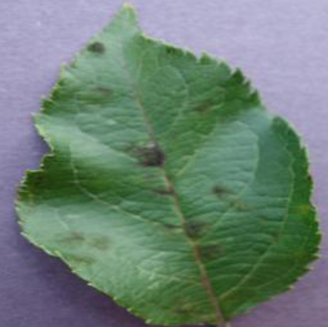
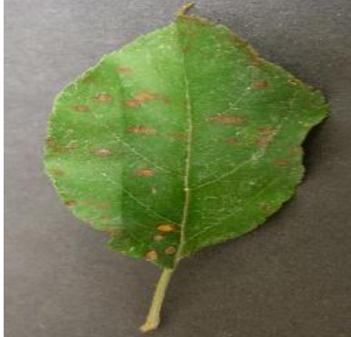
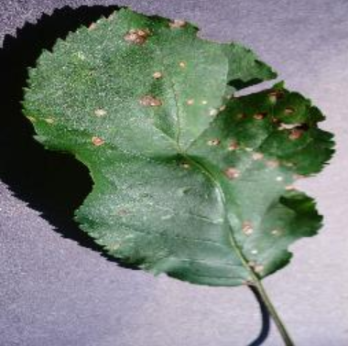
SAMPLE – DISEASED PLANT LEAVES

Slide 10
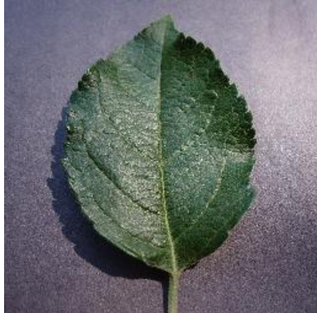
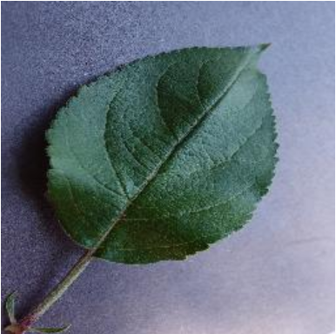
SAMPLE – HEALTHY PLANT LEAVES

Slide 11
MODULES

Slide 12
DATA PREPROCESSING
A total of 800 images for each class Diseased and Healthy is fed for the machine.
Conversion of image from BGR to RGB with the help of open CV library in python.
Conversion of image from RGB to HSV since HSV separates luma, or the image intensity, from chroma or the color information.
The Dataset is splitted into training and testing set with the ratio of 80/20 respectively.
Image Segmentation for extraction of Colors.
In order to separate the picture of leaf from the background segmentation has to performed, The color of the leaf is extracted from the image.
IMAGE SEGMENTATION

Slide 13
GLOBAL FEATURES
Applying Global Feature Descriptor. Global features are extracted from the image using three feature descriptors namely :
Color : Color Channel Statistics (Mean, Standard Deviation) and Color Histogram
Shape : Hu Moments, Zernike Moments
Texture : Haralick Texture, Local Binary Patterns (LBP)

Slide 14
FEATURE SCALING
Feature Scaling is a technique to standardize the independent features present in the data in a fixed range.
Here, we have used Min-Max Scaler. This scaling brings the value between 0 and 1.
After features are extracted from the images they are saved in HDF5 file that supports large, complex, heterogeneous data. HDF5 uses a "file directory" like structure that allows us to organize data within the file in many different structured ways, as we might do with files on your computer.

Slide 15
TRAINING
The Model will be trained over 7 machine learning models named :
Logistic Regression
Linear Discriminant Analysis
K Nearest Neighbours
Decision Trees
Random Forest
Naïve Bayes
Support Vector Machine
And the model will be validated using 10 k fold cross validation technique.

Slide 16
TESTING
Testing the prediction model
Calculating the accuracy of every model
Deciding which algorithm is best to be used for the problem, on the basis of the maximum accuracy achieved.

Slide 17
THANK YOU

